Slide 1
Group 3
Puzzle

Slide 2
Puzzle 3 Idea - Radio
External “people” can send us instructions for solving the next puzzle using a radio located in the room
Radio/Audioplayback device
Radio to receive a audiosample with noise – nothing is hearable
Audioplaybackdevice needs code to provide proper playback/start audiosample
Ether have real or fake noise on the audiosample
Another riddle to remove noise -> maybe a jammer in the room -> deactivate
Or amplify the signal in some case
Repair the radio in the first step to get the instruction
Only receive/transmit and receive

Slide 3
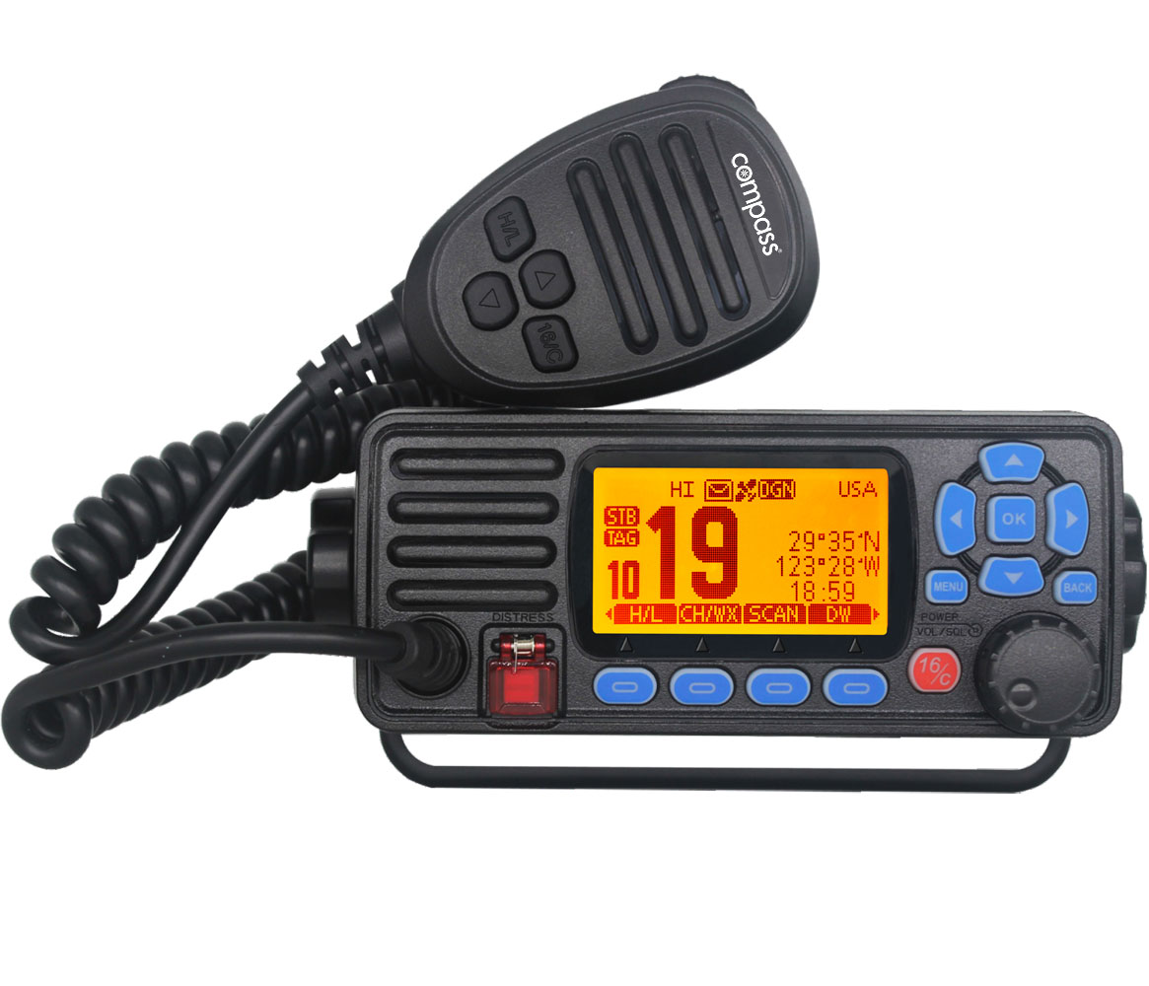
Puzzle 3 Idea 2
Radio plays news/emergency broadcast
Starts when emergency electricity is back on (or by solving another puzzle)
A sound/jingle is playing in the background or as a intro – repeated
Sound code is key to ??? – safe/door/etc. (buttons play same tone/sound)
A received code will lead to a hidden radio station – every other station will play the standard
Unknown person (aluhat guy/hobby radio operator) tells crazy story that leads to information for next puzzle

Slide 4
Ideas
Alternative: use recorded alternated voice, change pitch to
match a doorlock controlled with by voicerecognition (use real voicerecognition/just use potis?)
Hide information in background noise -> amplify the noise
Snake game on LED matrix(maybe roomscale) which displays information after eating X blocks
Use close contact RFID readers in the room and place corresponding tags close to it
Riddle to figure out which tags belongs where/maybe give hints where the tags are hidden
RFID riddle / mastermind game to generate a code

Slide 5
Scenario Idea: Solarstorm shutdown
Radio is broken after power is back on
Lights back on
Safe is old and unreliable and resetted its passcode
System admin stored the passcode somewhere in the room

